Slide 1
Tobor Inc
Backend Automation for user management and content aggregation

Slide 2
Why RPA
Robotic Automation Processes are an ingenious tool that helps business to execute some of the more tedious and repetitive work effort that their employees are spending most of their time on rather than focusing on business growth projects.
Tobor Inc is such a company. It is estimated that half of their working day is spent on dealing with user requests and sending out emails, which can be easily remedied with the use of RPA

Slide 3
The process
The Beauty of RPA is its capability to mimic human interactions with any given computational process. Therefore your best resources are the employees during development, asking them how they perform each process ‘click by click’ will paint a very clear picture and provide a solid workflow.
Given the current climate that has had to be executed remotely via emails between the developer and the Backend Application Manager.

Slide 4
Process Assessment & Prioritisation
Analysis of: Size, Complexity, Fluidity, Occurrence, Implication, Exception and Value
Size
Complexity
Fluidity
Occurrence
Implication
Exception
Value
User Journey
Emailing Content
Reporting
Poor
Candidate
Compelling
Candidate
Notes:
Process Review leads in to Scoring and Prioritisation
Real life example scoring from a Discovery Workshop
Detail 7 Criteria
Visual method, created collaboratively – ideal is a clear consensus
Example Process E looks ideal
Customer proceeded with Process D
Ensure Drivers & Goals fit
More in line with their expectations

Slide 5
Detailed Process Document (DPD)
This document outlines in detail all the information that was acquired during requirements gathering stage.
The document is considered a ‘live’ and can be updated simultaneously along side development and is very flexible to change.
This documentation must be signed by all stake holders at the beginning, so that development may commence.

Slide 6
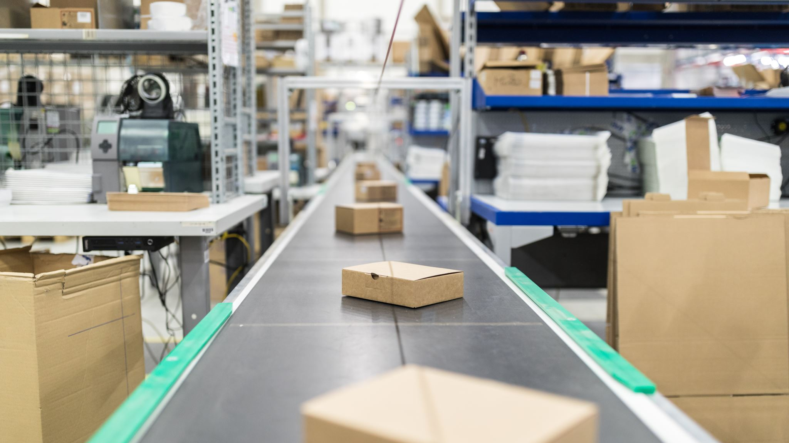
The Automation

Slide 7
Self Reflection
During Development there were several stumbling blocks, most I was able to pull through, but some have been highlighted as an area that requires improvement.
There are areas of the development that have been impacted by this and has reduced the amount of time I had to completed this project as anticipated.
Thank you for Listening

